Slide 1
Cloning the Repository to Another PC
for Group Access

Slide 2
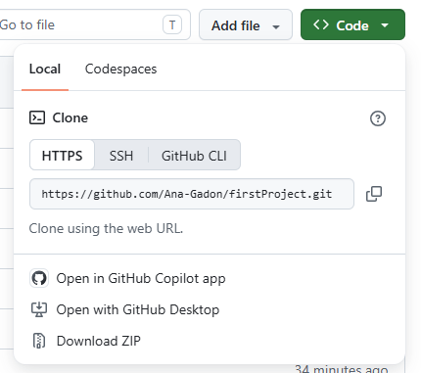
Copy the GitHub repository URL
  Open your GitHub repository.
  Click the green Code button.
  Select HTTPS.
  Copy the repository URL.

Slide 3
Setting Up a New Capacitor Project with GitHub
Prerequisites
Install these first:
Node.js (v18+) — includes npm: https://nodejs.org
Git: https://git-scm.com
GitHub account: https://github.com

Slide 4
Clone the repository
Open Command Prompt (CMD) or PowerShell.
Navigate to the folder where you want to save your project:
example: cd Documents
Clone the repository:
git clone https://github.com/Ana-Gadon/firstProject.git
Go inside the project folder:
cd firstProject
Open the project in VS Code
code .

Slide 5
Run project
npm install
npm run build
npx cap sync
npx cap run android

